Slide 1


Evidence-Based Software Engineering
A comprehensive training module on systematic reviews and evidence-based practices for software engineering research and practice
SE-ALL LAB

Slide 2
01. Introduction to EBSE
Understanding evidence-based software engineering principles and applications
02. Purpose & Benefits
Contents
Exploring why EBSE matters for research and practice decisions
03. Secondary Study Types
Systematic reviews, mapping studies, and rapid reviews explained
04. Review Process
From protocol development to execution and reporting

Slide 3



What is Evidence-Based Software Engineering?
Core Definition
EBSE applies evidence-based principles from medicine to software engineering, using systematically collected empirical evidence to support decisions about methods, tools, and practices rather than relying on intuition alone.
Evidence-Driven
Systematic Approach
Integrates best available research with professional judgment for informed decision-making
Emphasizes rigor, replicability, and transparency in evidence collection and analysis

Slide 4
Purpose of Evidence-Based SE
Summarizing Knowledge
Supporting Decisions
Provides structured overviews of existing studies on software engineering topics and methods
Helps practitioners choose appropriate technologies and methods based on empirical evidence
Reducing Risks
Identifying Gaps
Prevents adoption of ineffective or harmful tools and practices through evidence-based evaluation
Reveals areas where evidence is missing or inconclusive, guiding future research directions

Slide 5



EBSE for Graduate Students
Undergraduate Level
Systematic review exercises train critical reading skills and understanding of knowledge accumulation in SE
Master's Level
SLRs provide thesis foundation through structured surveys of existing work and research question identification
PhD Level
Reveals deeper research gaps, justifies novelty, positions contributions within literature, often publishable as standalone papers

Slide 6

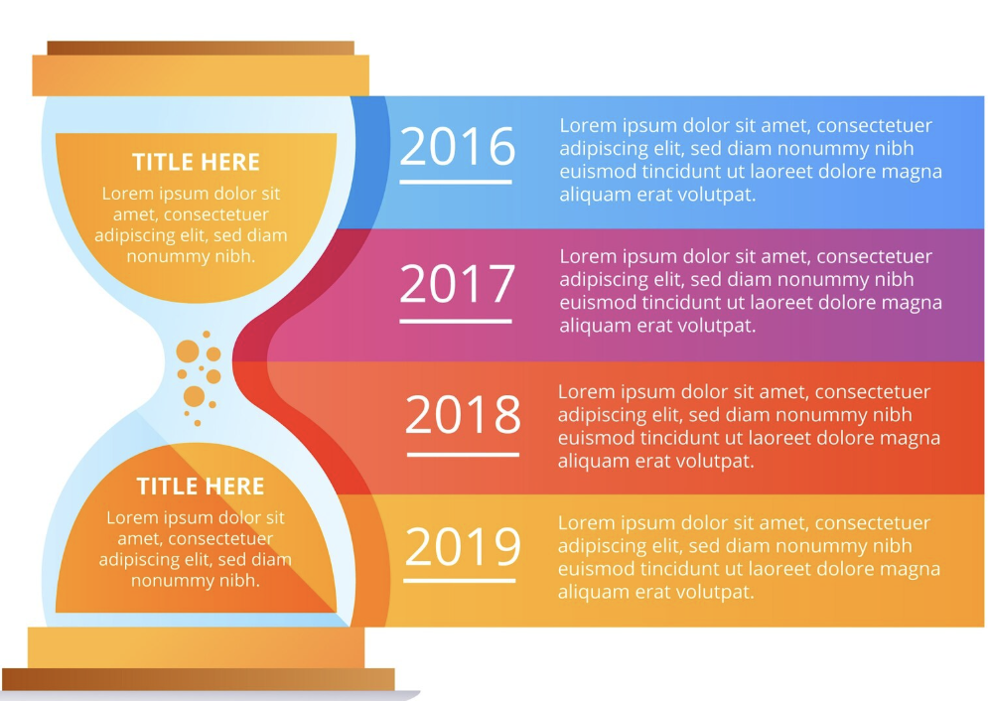

Types of Secondary Studies
Systematic Literature Review (SLR)
Systematic Mapping Study
Rapid Review
●
Streamlined version of SLR for speed
●
Comprehensive synthesis of all relevant studies
●
Categorizes and classifies existing research
●
Sacrifices comprehensiveness for timeliness
●
Emphasizes rigor, replicability, and transparency
●
Provides broad overview of trends and distribution
●
Used when timely evidence is needed
●
Addresses specific research questions systematically
●
Emphasizes breadth over depth in analysis

Slide 7


The Review Process: From Protocol to Execution
Planning Phase
Develop protocol with research questions, search strategy, inclusion/exclusion criteria, and quality assessment plans
Conducting Phase
Execute searches, screen studies, assess quality, extract data using predefined forms, and analyze findings
Reporting Phase
Present transparent evidence chain, synthesis results, and provide evidence-based recommendations for practice

Slide 8
Protocol Development Essentials
Protocol Components
A comprehensive protocol ensures transparency, replicability, and credibility in systematic reviews
Research Questions
Search Strategy
●
Clear, focused, and answerable questions
●
Structured search strings with keywords
●
Guide the entire review process
●
Boolean operators (AND, OR, NOT)
●
Define scope and boundaries
●
Database-specific syntax adaptation
Inclusion Criteria
Quality Assessment
Data Extraction
Define what studies to include or exclude
Evaluate study rigor and reliability
Specify what data to collect consistently

Slide 9

Key Takeaways for Students
Essential Principles
EBSE emphasizes systematic use of evidence through structured secondary research methods with clear protocols
Systematic Approach
Protocol Development
Structured Process
Use evidence systematically rather than relying on intuition alone
Essential for credibility, replicability, and transparency
Adaptable framework with clarity, rigor, and transparency as core principles

Slide 10
Evidence-Based Software Engineering
A comprehensive training module on systematic reviews and evidence-based practices for software engineering research and practice
SE-ALL LAB

